Slide 1
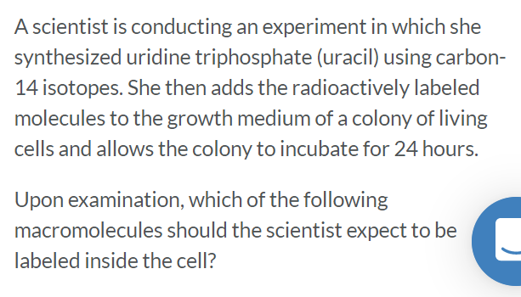
A. RNA B. Triglyceride C. Glycogen D. Cellulose

Slide 2
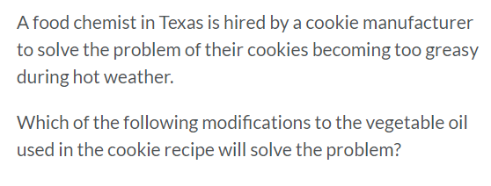
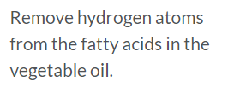

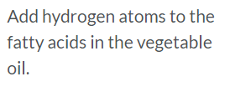

Slide 4
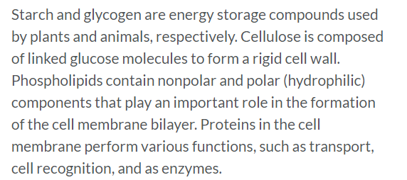

Nitrogen Phosphorus Oxygen Carbon

Slide 5

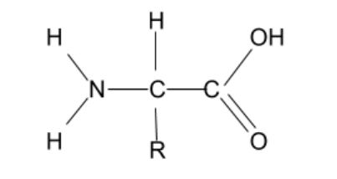
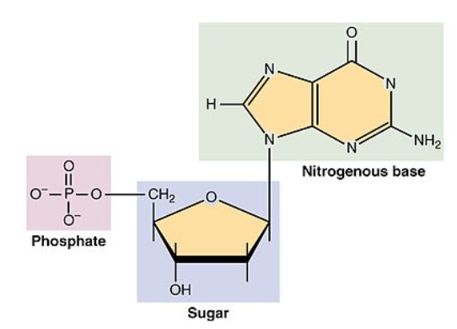
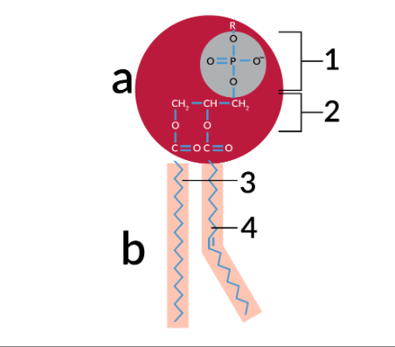

Slide 6
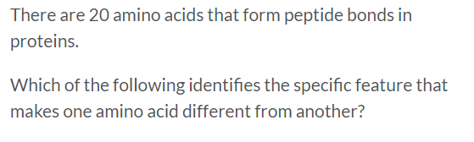
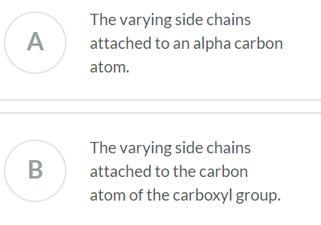
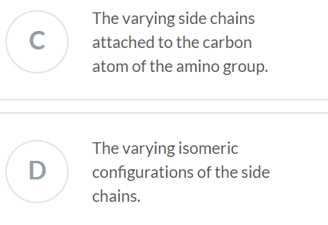

Slide 7
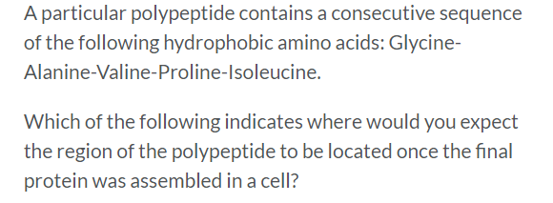
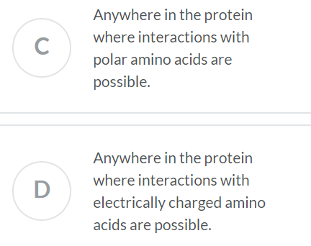
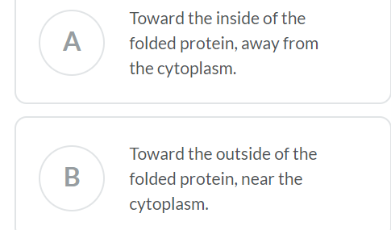

Slide 8
https://www.khanacademy.org/science/ap-biology/chemistry-of-life

Slide 9
Primary protein structure involves what type of bond?
a) hydrogen
b) covalent
c) ionic
d) hydrophobic

Slide 10
Beta sheets are an example of what level of structure?
a) primary
b) secondary
c) tertiary
d) quaternary

Slide 11
The primary structure of protein is written ___ to ___.
a) 5' . . . 3'
b) N . . . C
c) C . . . N
d) A . . . Z

Slide 12
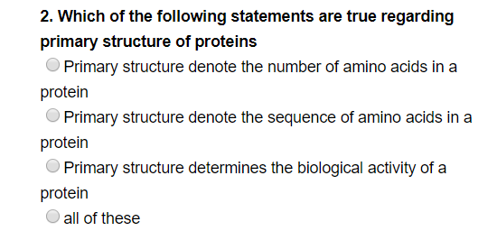

Slide 13
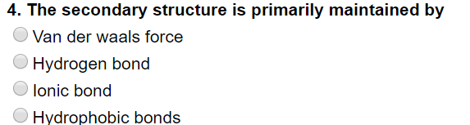

Slide 14
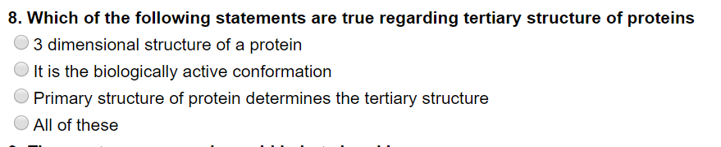

Slide 15

A. Primary B. Secondary C. Tertiary D. Quaternary

Slide 16
The bonding of two amino acid molecules to form a larger molecule requires
the release of a water molecule
the release of a carbon dioxide molecule
c.. the addition of a nitrogen atom d. the addition of a water molecule e. an increase in activation energy

